Slide 1
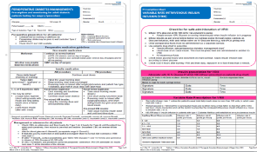
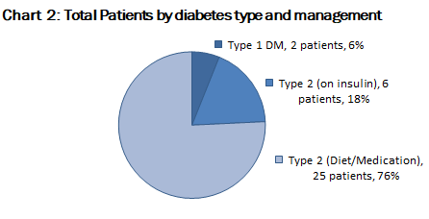
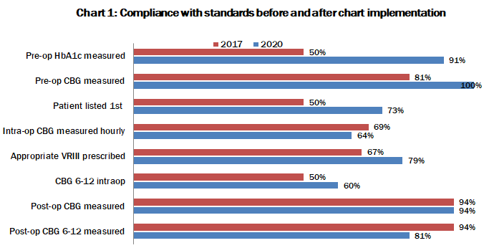
Peri-operative diabetes management
in an adult tertiary centre
Dr Sarah Hoskins¹, Dr Carly Webb¹, Dr Hannah Wilson²
1, Speciality Trainee. 2, Anaesthetic Consultant and Perioperative medicine lead
Introduction
Diabetes management was a top PQIP priority for 2019/20, and the recent NCEPOD report highlighted the overarching theme of lack of clinical continuity of diabetes management across the specialities in the perioperative period. ¹
Previous work in our trust in 2017 demonstrated scope for improvement in meeting recommended standards within the JBDS² and AAGBI perioperative diabetic management guidelines. ³
This lead to implementation of a ‘one stop’ perioperative diabetic management chart aimed at improving compliance with national guidelines. ^{1,2,3,4,}
The chart incorporates preoperative medication changes, VRIII prescription and sub cutaneous insulin use for hyperglycaemia, plus CBG recording within one document.
Results (See chart 1 and 2)
33 patients had data available, 6% were Type 1 (see chart 2).
1 patient received sub cut insulin for hyperglycaemia pre operatively.
3 patients were cancelled on the day of surgery due to lack of HDU beds (2) and no time on theatre list (1)
7 patients with inadequate CBG monitoring were known poorly controlled diabetics with HBA1c >69 and 1 had an elevated CBG in recovery that needed management with a VRII.
5 patients had post operative infective complications , 2 of which had poorly controlled diabetes
Conclusion
Pre and post-operative use of the chart is consistently good and since its implementation, our audit has demonstrated better use of VRIII and documentation of both preop CBG and HbA1c.
Further work including education and training is planned to further improve intraoperative CBG monitoring and documentation.
Scheduling issues identified which can result in prolonged fasting periods and day of surgery cancellations will be addressed
Some avoidance of VRII use was pragmatic and appropriate in short procedures
Use of dexamethasone in 5 patients was felt to be detrimental to perioperative diabetic control and it’s future use was discouraged.
Increased electronic recording of CBG perioperatively may ensure continuity of care and ease of accessing data from the perioperative period.
We embrace the call from CPOC for further research to address the deficits in perioperative diabetic managements that currently exist.
The most recent PQIP data within our trust identified a cohort of 8.5% diabetic patients, which is slightly below the national average of 10-15%.²
Whilst highlighting excellent recording of HbA1c preoperatively, we wanted to see if implementation of a one stop diabetes management chart had improved our overall perioperative care.
Methods
Data was collected for all diabetic patients undergoing elective surgical procedures at all Bristol sites within the trust between Jan 2020 and March 2020
Standards audited were as per AAGBI guidance listed in Chart 1.³
We also looked at organisational factors, fasting times and the outcomes of poorly controlled diabetics that underwent surgery as per NCEPOD and CPOC standards. ^{1,4}
References ¹NCEPOD Highs and Lows. A review of the quality of care provided to patients over the age of 16 who had diabetes and underwent a surgical procedure. 2015
² Joint British Diabetic Societies for Inpatient Care JBDS- IC
Management of adults with diabetes undergoing surgery and elective procedures: Improving standards. Revised September 2015
³ Association of Anaesthetists of Great Britain and Ireland. Peri operative management of the surgical patient with diabetes 2015. Anaesthesia 2015; 70: 1427-1440
⁴ Centre for Perioperative Care. Guideline for Perioperative Care for People with Diabetes Mellitus Undergoing Elective and Emergency Surgery March 2021
Acknowledgments: With thanks to Dr N Thorogood and Diabetic MDT at UHBW for their input and consensus advice.

